Slide 1


Kandean
Personalized your own recipes and digital fridge
22207232 Qiyue Zhu
11/30/2024

Slide 2

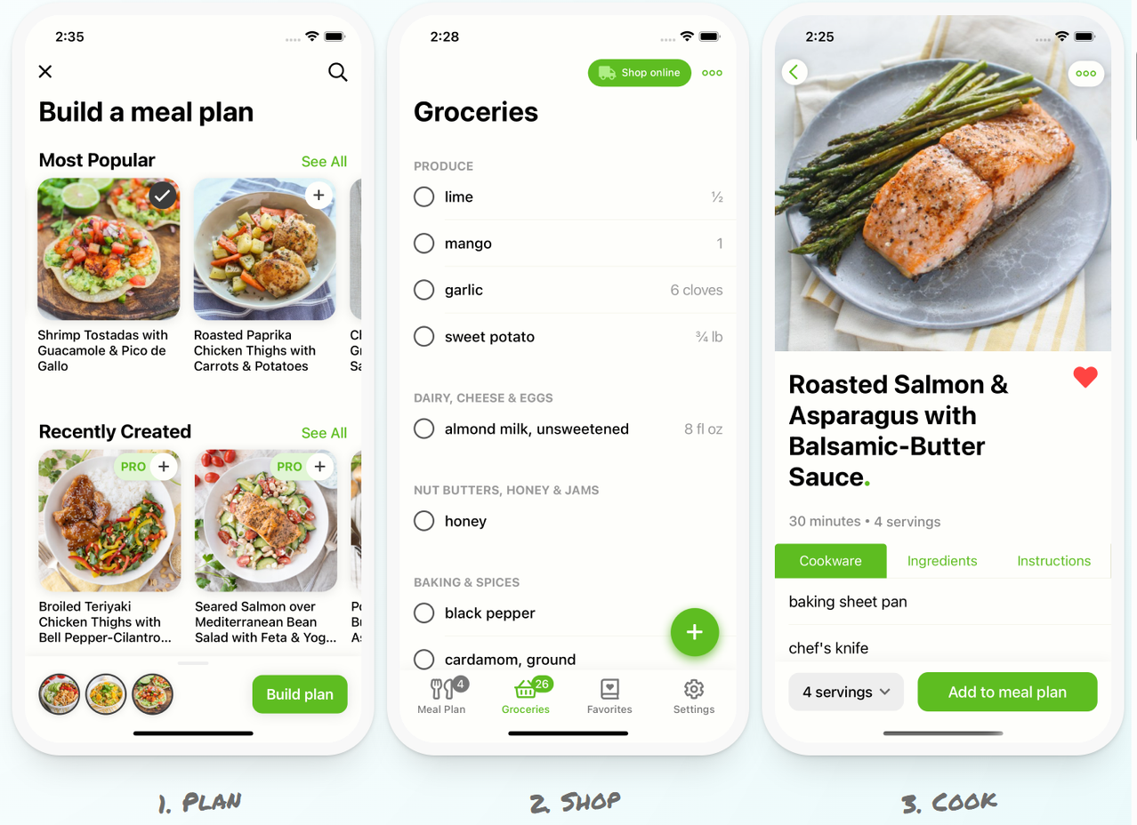
Example Application: Mealime
Mealime focuses on meal planning and grocery shopping, offering healthy recipes that cater to various dietary preferences.
It creates personalized meal plans based on the user’s dietary restrictions and tastes.

Slide 3
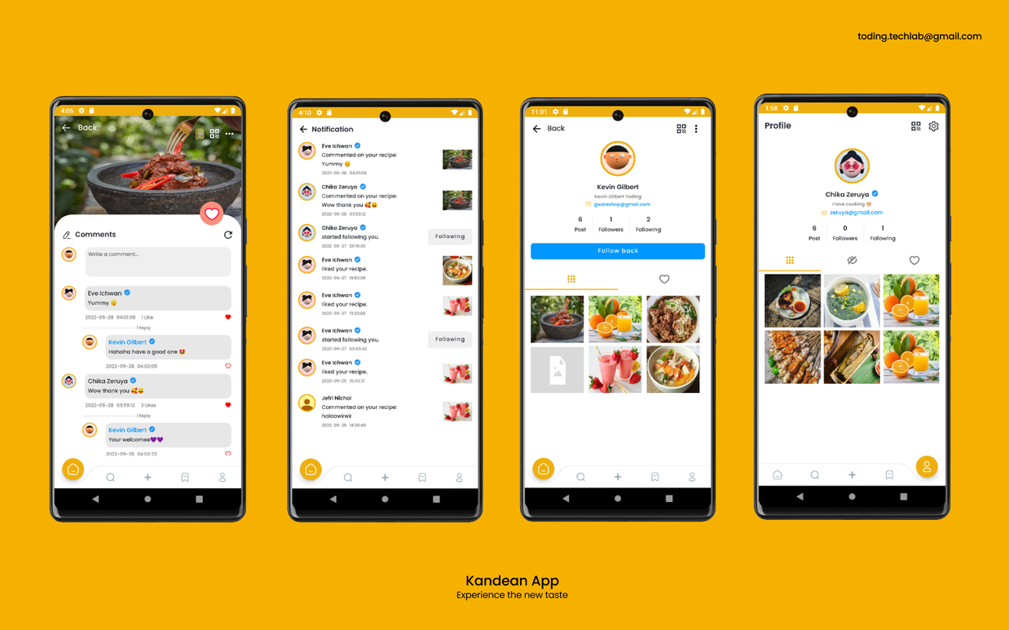
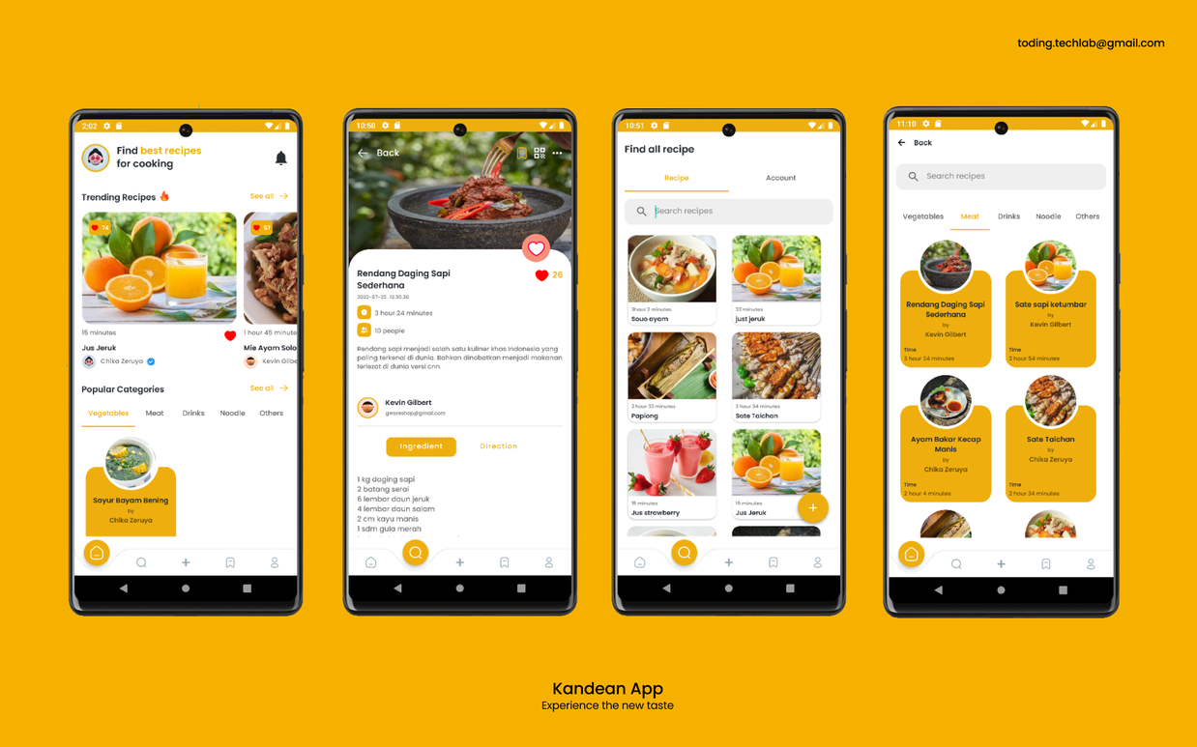
The Chosen App: Kandean
A beautiful UI
Share recipes like Instagram, you can like and comment, and receive notifications when someone likes or comments on your post
Edit your own recipes
Search recipes
Suggest the trending recipes or popular categories
Support QR Code scanning to find recipes and user accounts

Slide 4





Timeline
Add an image-recognition API that enables users to scan items to add new items automatically, and add new shopping list pages which enable users to auto-create shopping list when lacking ingredients.
Set up the new basic pages and layout of the digital fridge page
BETA
SUBMISSION
Automatically decrease the quantity of an ingredient in the digital fridge when it is used in a recipe.
ALPHA
SUBMISSION
FINAL
SUBMISSION

Slide 5
Function Achieved 1:
AI-supported Image Recognition
Complete the scan item function by introducing the image-recognition technique to automatically add new item to the digital fridge.
EXTERNAL RESOURCE USED:
Baidu Image Recognition Technique

Slide 6
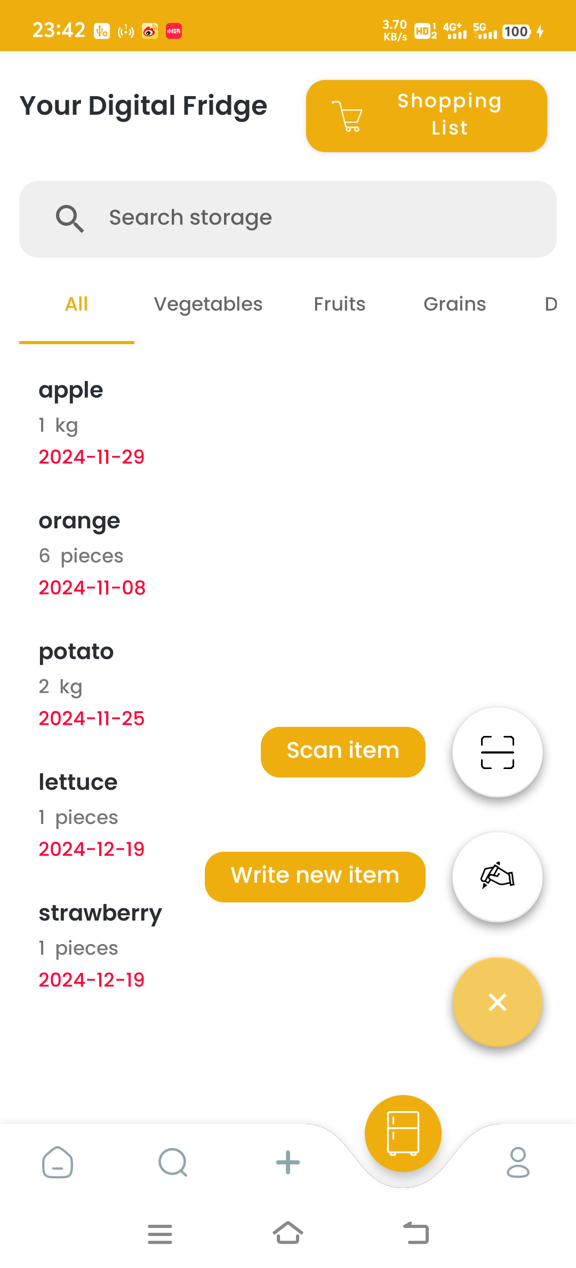
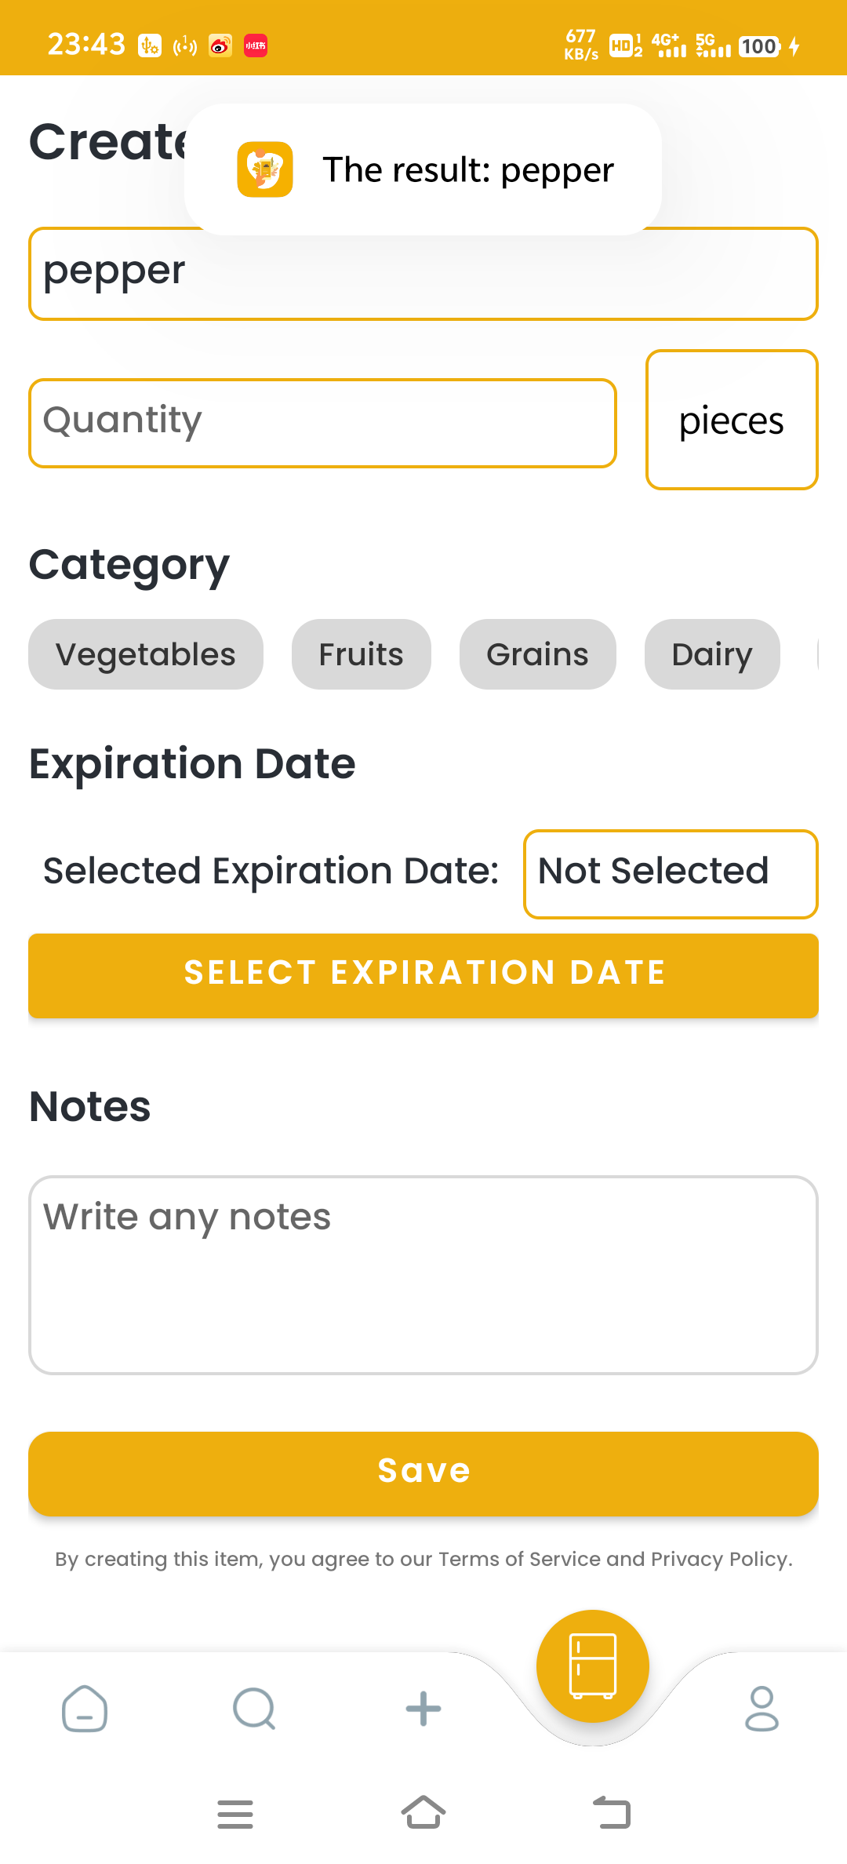
Function Achieved 1
1
The AI-supported scanning function
The function is implemented by introducing Baidu image recognition interface.
By clicking the “scan item” floating button and choose an image of the ingredient you want to add, you can add that ingredient automatically.
This process can be viewed in the video.

Slide 7
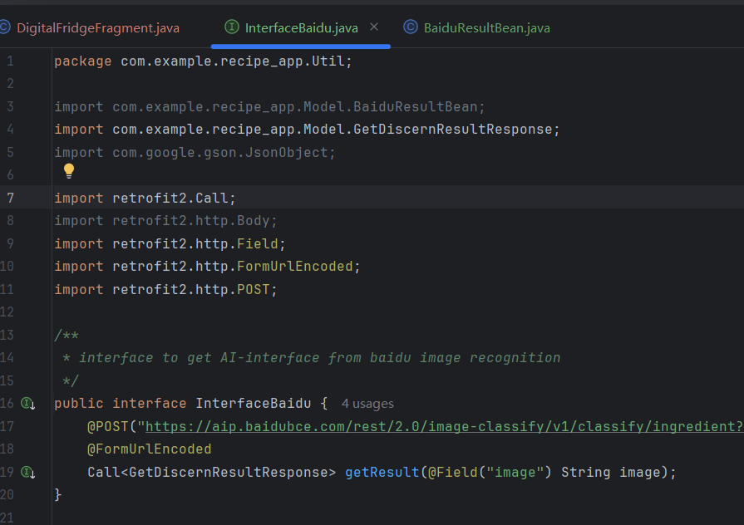
Code explanation
This class set an interface to send a request with the image to Baidu.

Slide 8
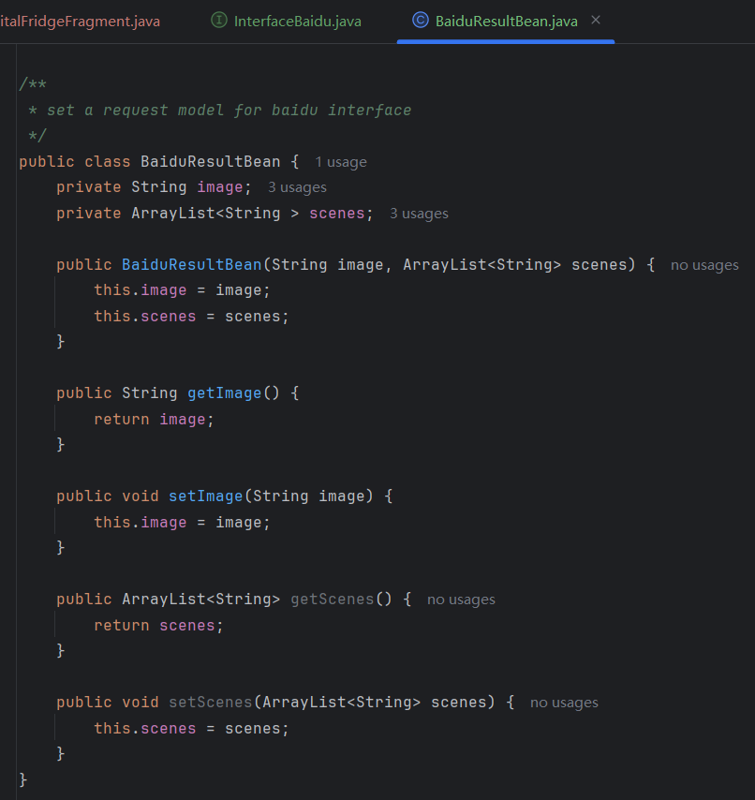
Code explanation
This class set a model for Baidu interface’s request to upload the image to Baidu system to analyze and return result.

Slide 9
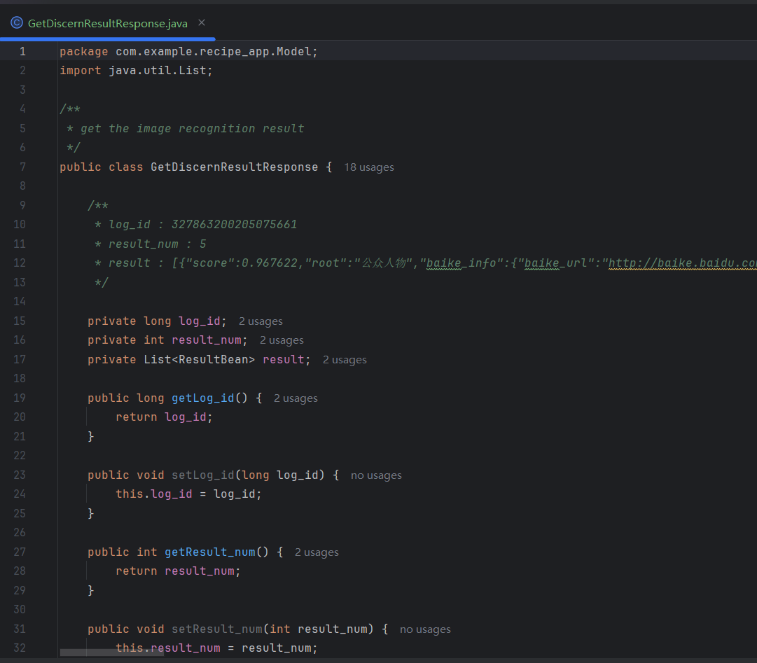
Code explanation
This class set a model for Baidu interface’s result to process the json result and split them into useful parts since the reply contains 5 results and ordered by their scores. Here I will use the highest score, which is the most similar one.

Slide 10
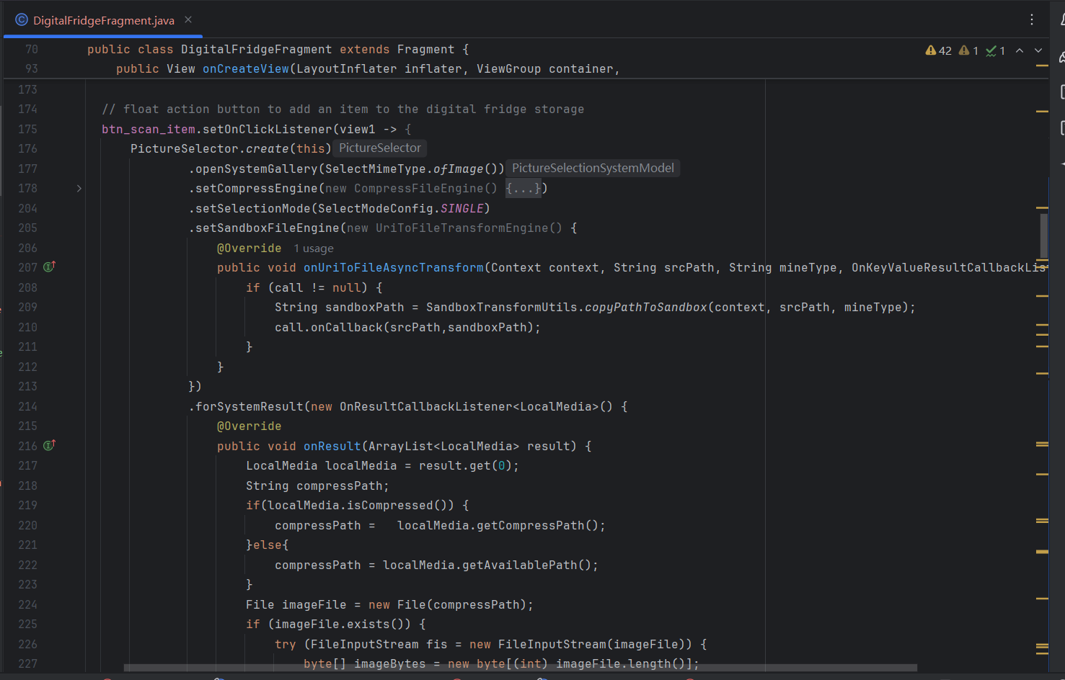
Code explanation
Here I set the pick image action when clicking the scan button.
And it will be uploaded to Baidu interface to be analyzed.

Slide 11
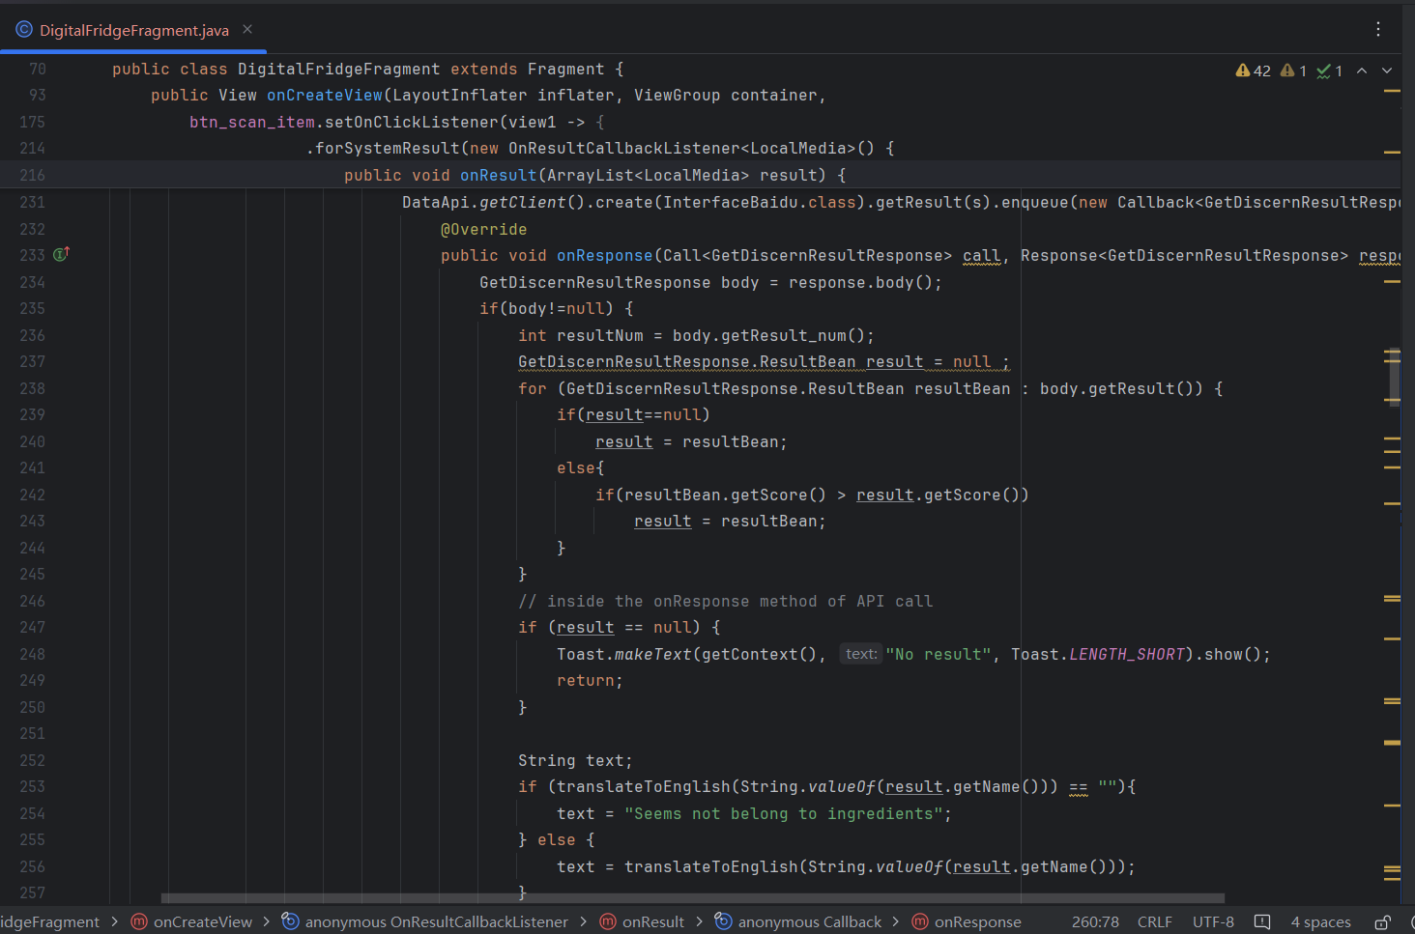
Code explanation
Here I analyze the result and split them into different situations.
If it is null, a toast will pop up to notify you about the not found result.

Slide 12
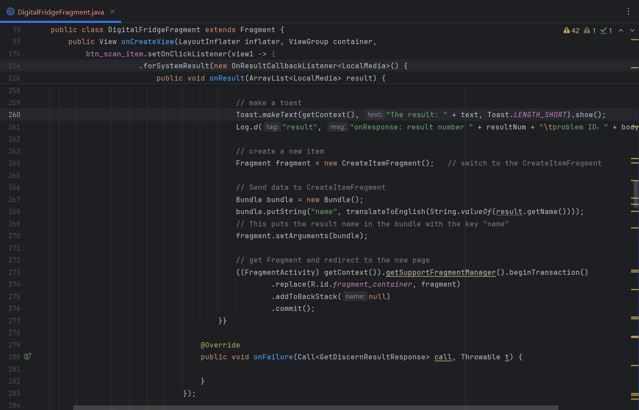
Code explanation
If it is not null, a toast will pop up to notify you about the image- recognition result and transfer to the create new item page with auto-filled fields.

Slide 13
Function Achieved 2:
Add Shopping List Pages
A shopping list supports handwriting or scan item’s image to add new items.

Slide 14
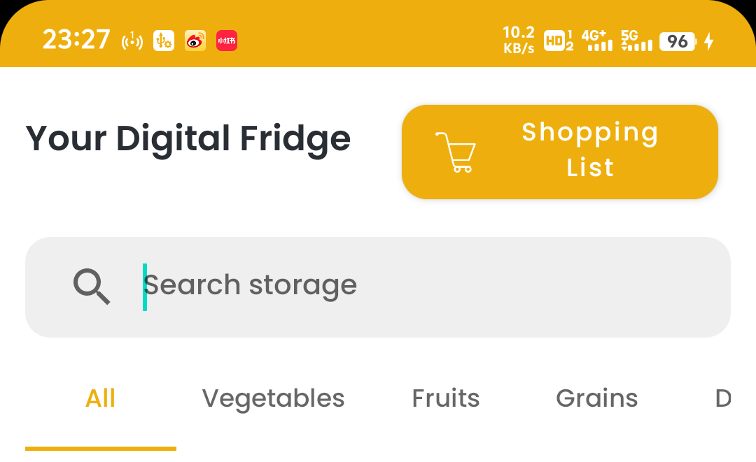
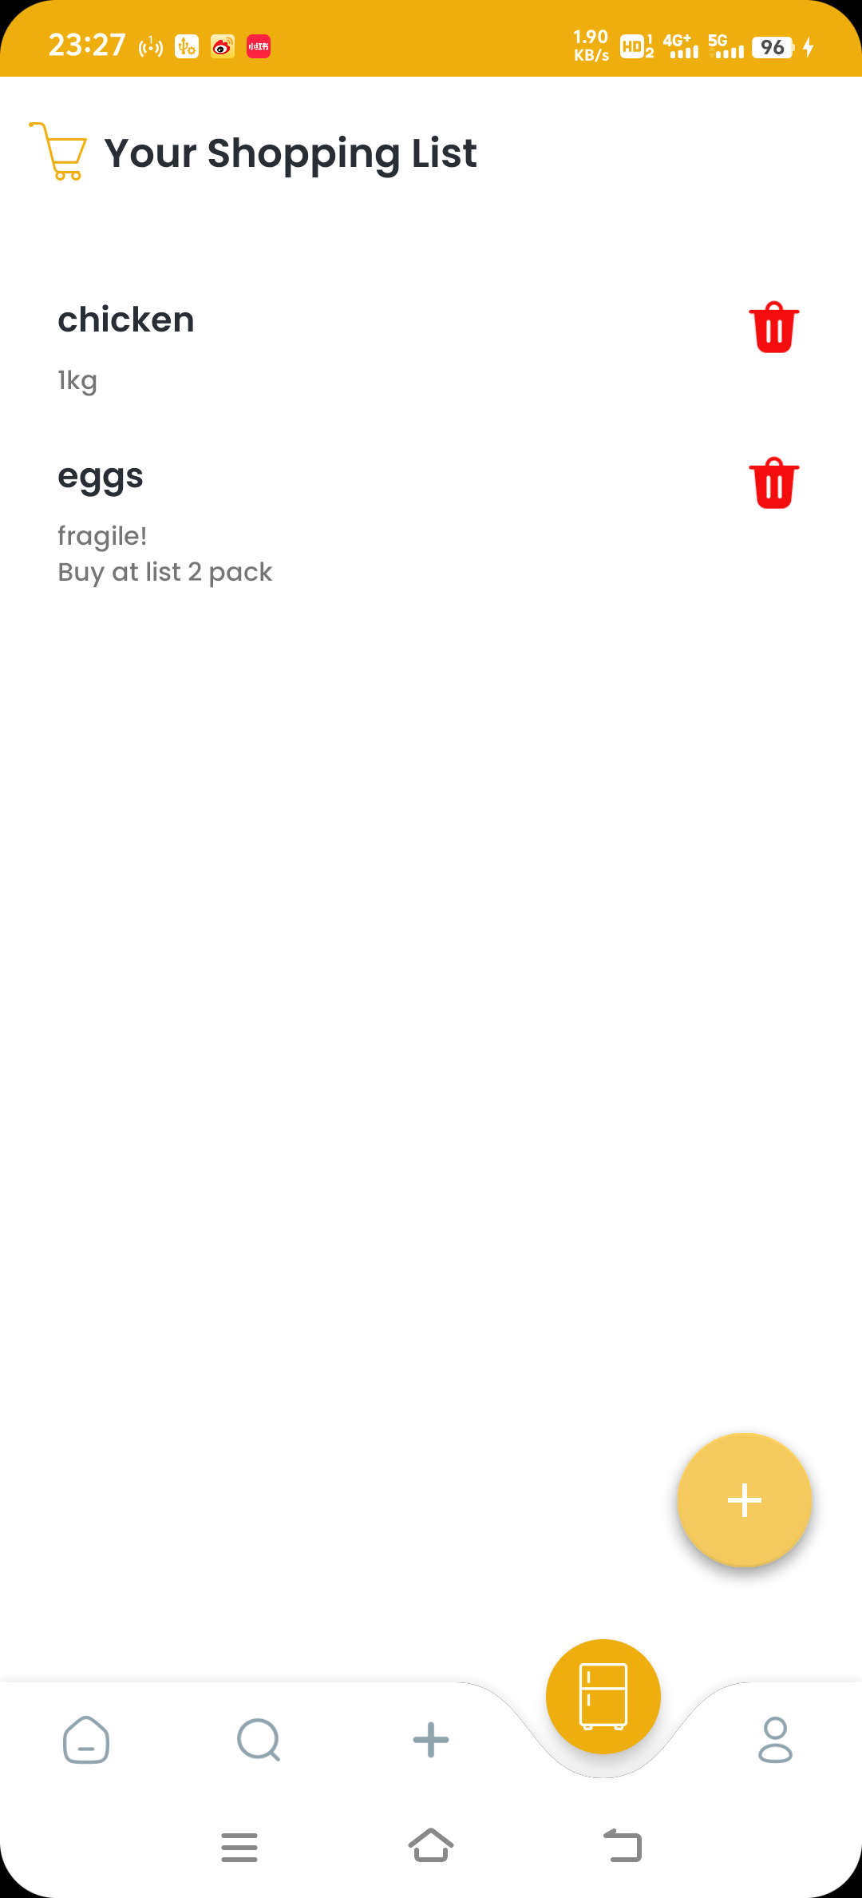
Function Achieved: 2
2
Shopping List Pages: Main View Page
Here shows how to enter the newly-developed shopping list pages.
I add a shopping list button on the digital fridge page, by clicking that, you can enter this page.
This page will show you every item in your shopping list.

Slide 15
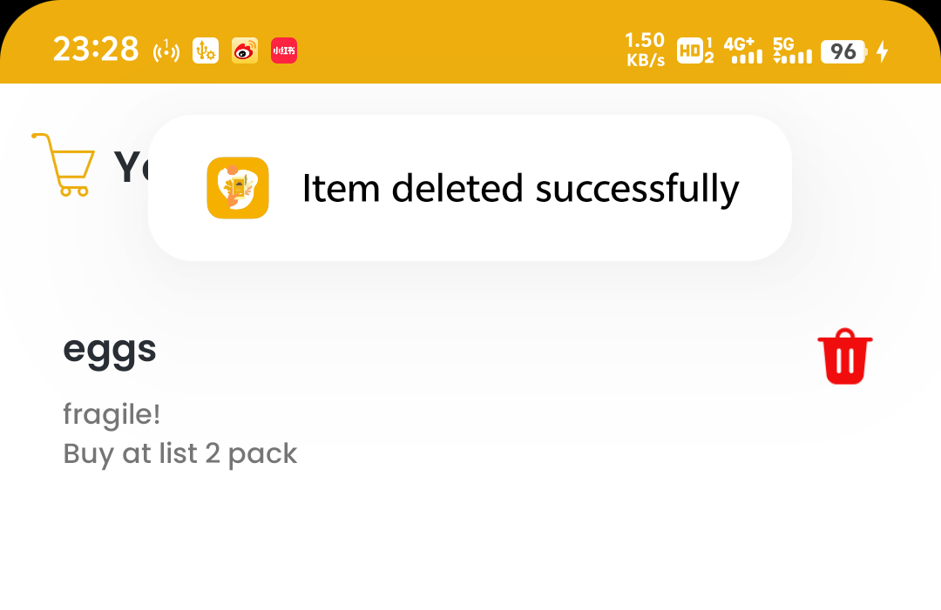
Function Achieved: 2
2
Shopping List Pages: Delete Item
Here shows the delete function.
You can delete an item by clicking the red trash icon on the right-hand-side of that item.

Slide 16
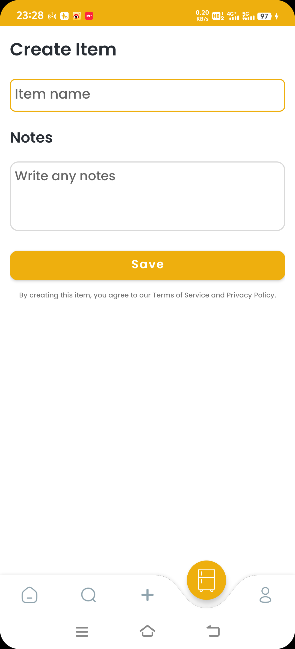
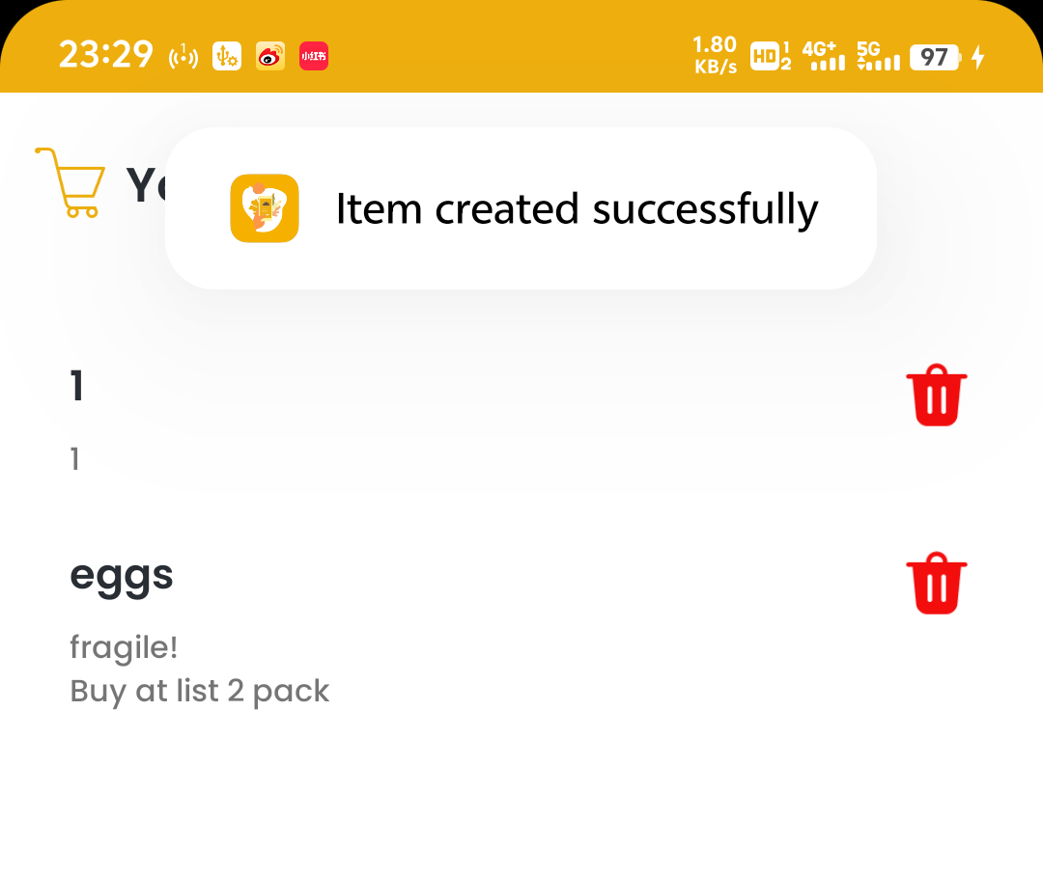
Function Achieved: 2
2
Shopping List Pages: Add Item Page
Here you can add an item to your shopping list.
This page can be entered from the shopping list pages by clicking the handwriting button or the scan button, same as the digital fridge pages.
This page is linked with recipes, which will be stated later.

Slide 17
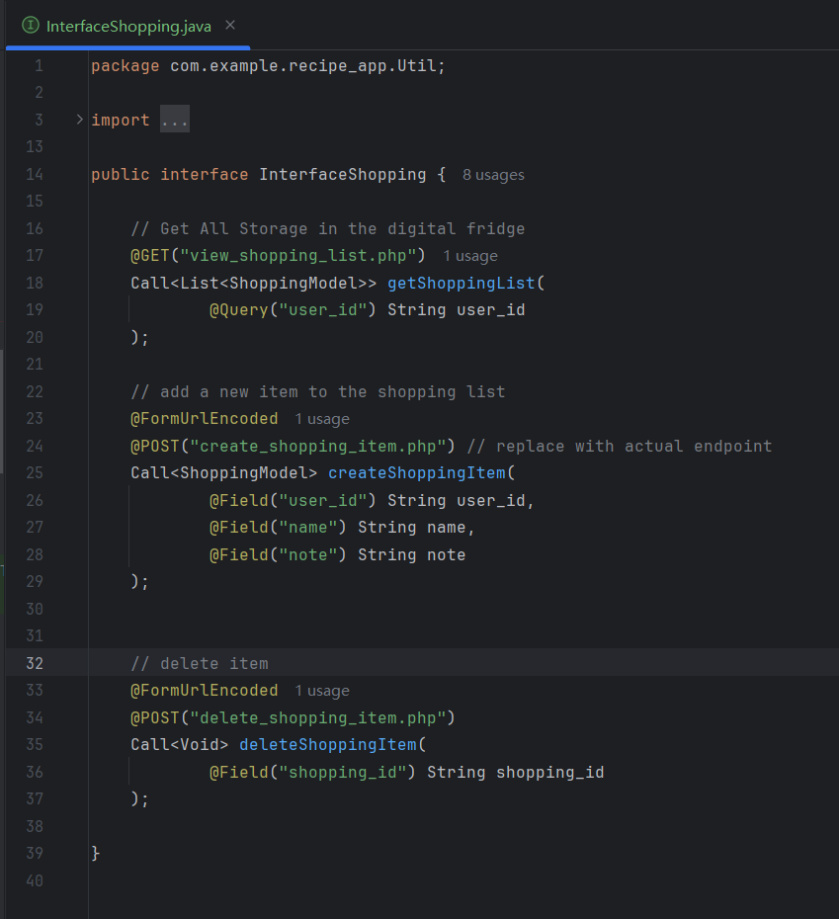
Code explanation
Here is the interface of all the shopping list pages related to the database, this will search for each php file and passing them the necessary information.

Slide 18
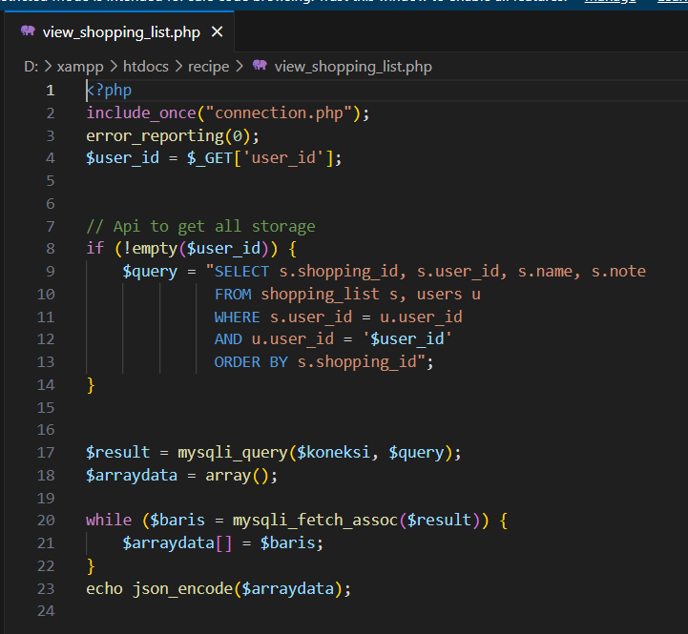
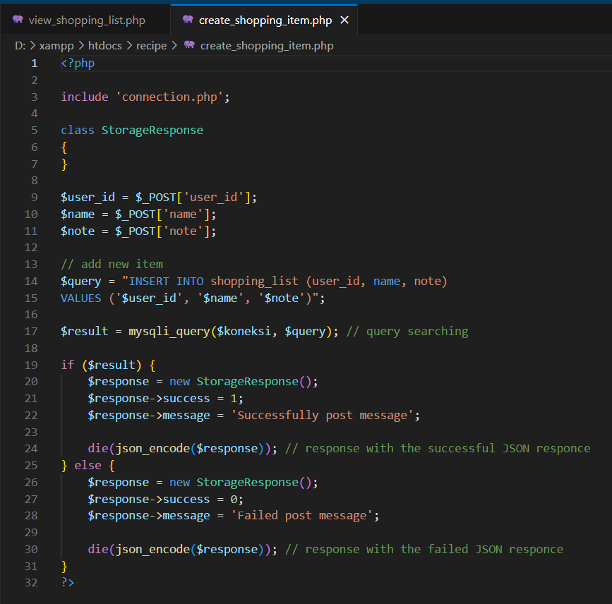
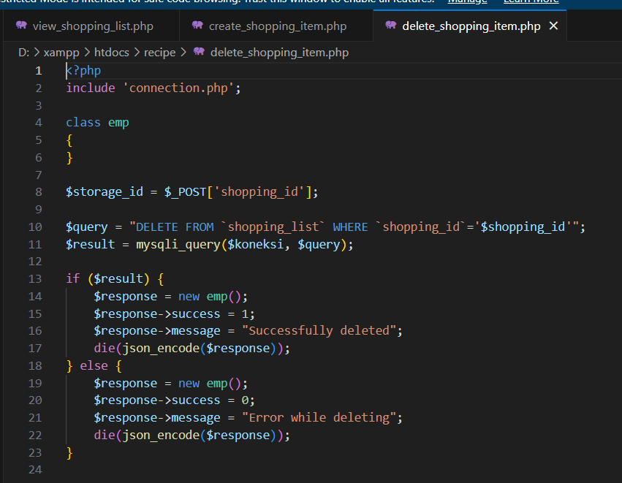
Code explanation
Here is the php files to get the necessary information and post corresponding requests to the database.

Slide 19
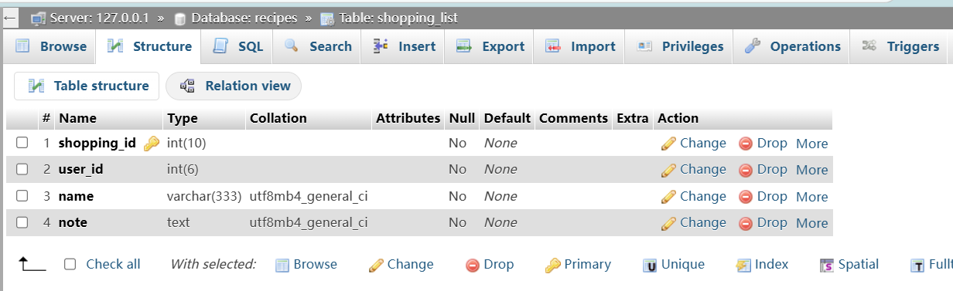
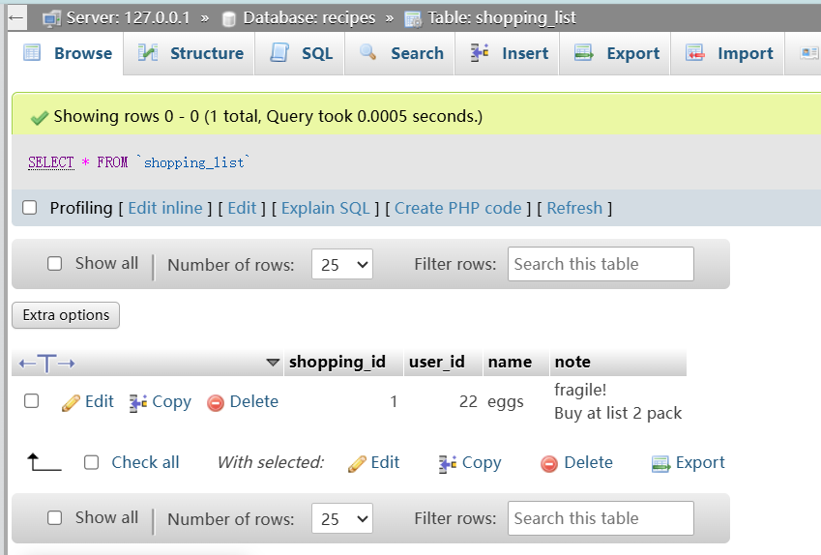
Code explanation
Here is the table of the shopping list pages: shopping_list.

Slide 20
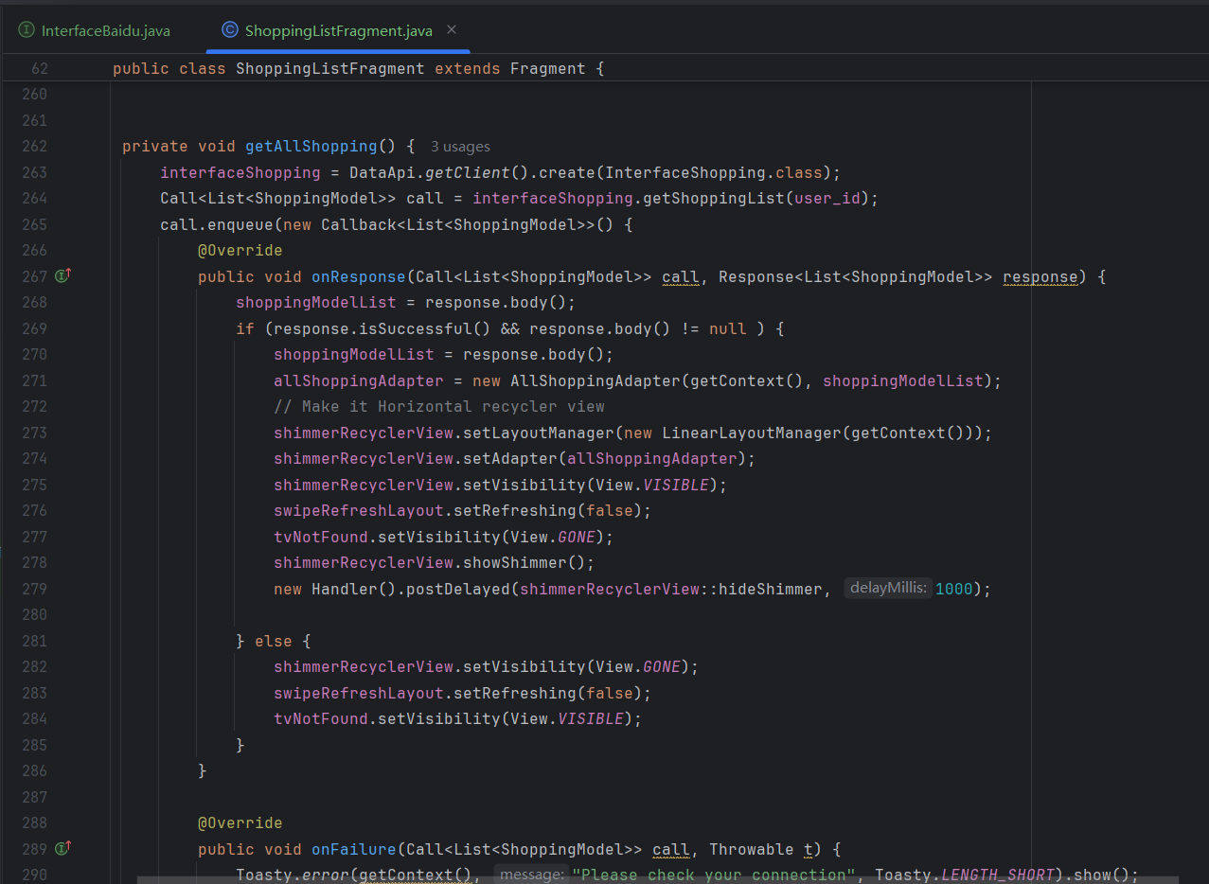
Code explanation
Here is the main page of the shopping list, where you can view all items in your shopping list

Slide 21
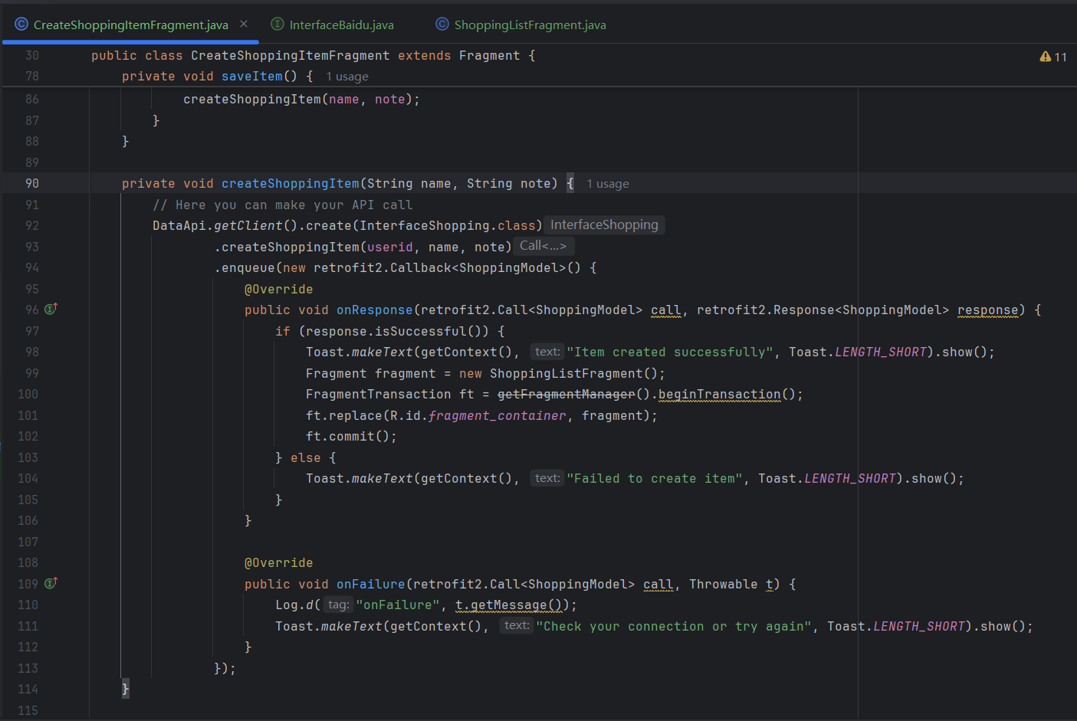
Code explanation
Here is the create item page of the shopping list, where you can add new item to your shopping list

Slide 22
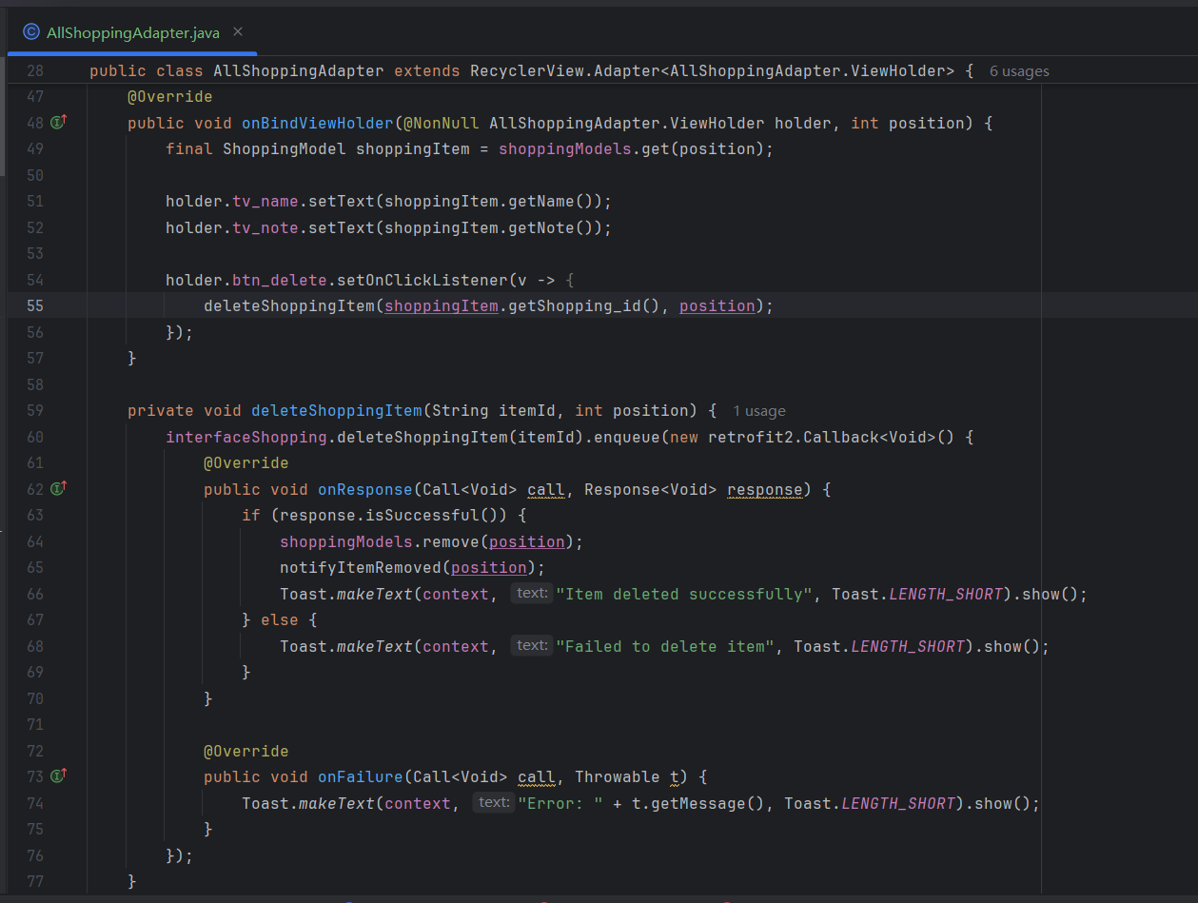
Code explanation
Set the view of each item and perform deletion when clicking the trash icon in the rear of that item.

Slide 23
Function Achieved 3:
Auto-create A New Item If Needed
A new item can be created automatically when you lack that ingredient in your digital fridge.

Slide 24
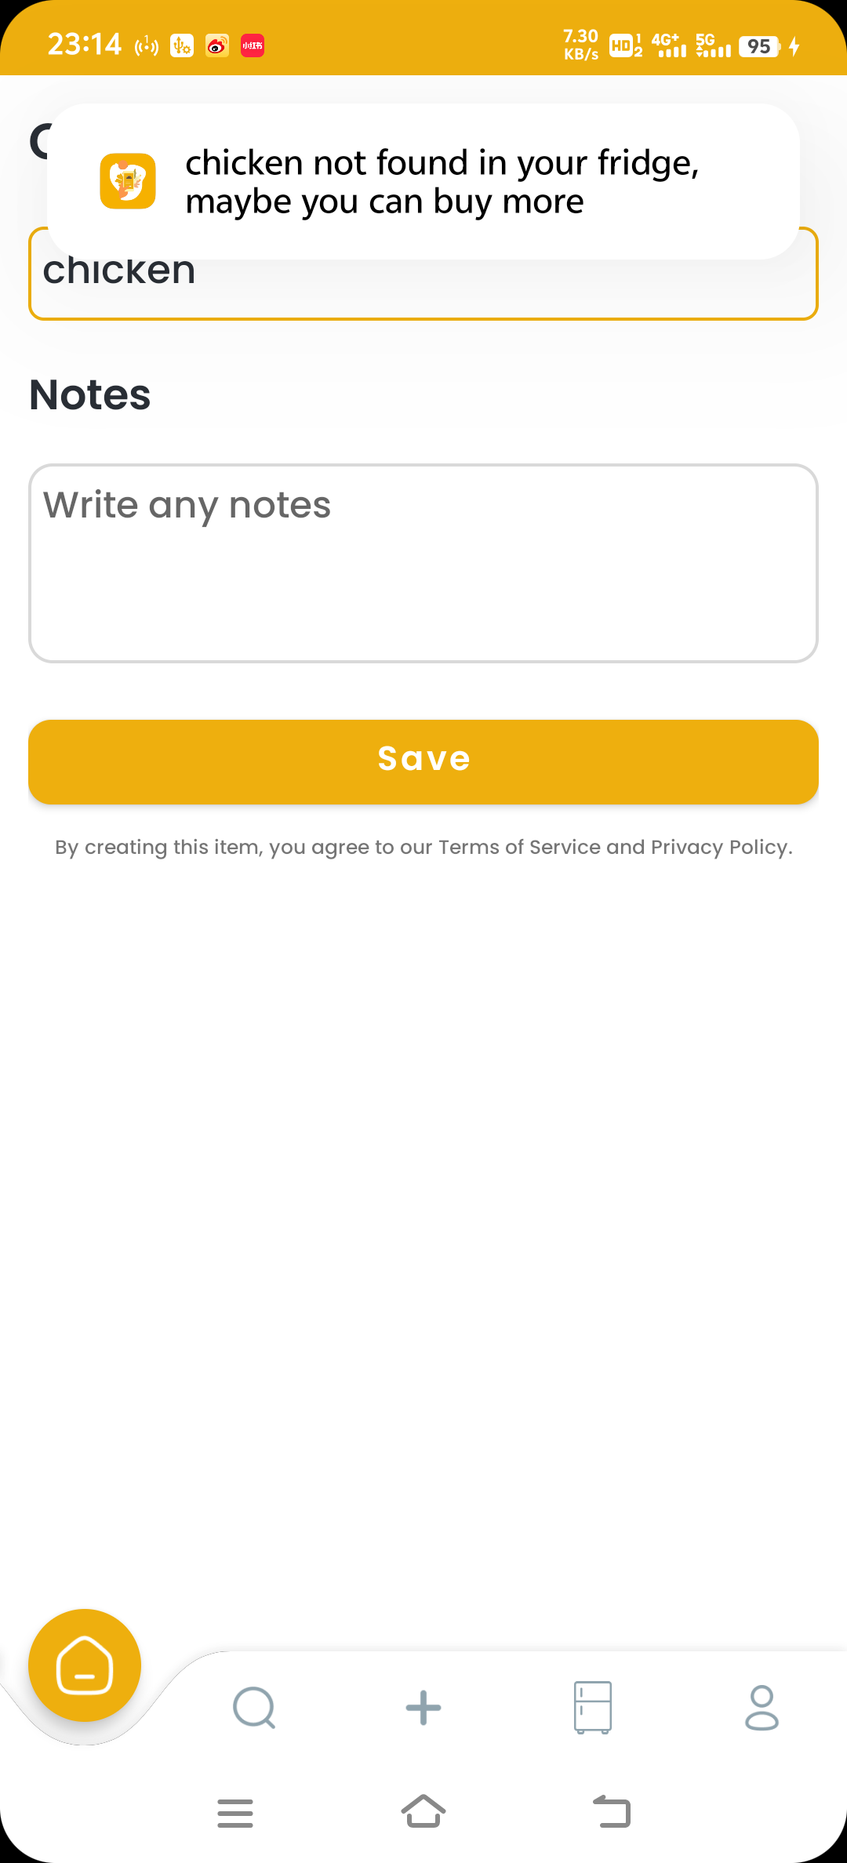
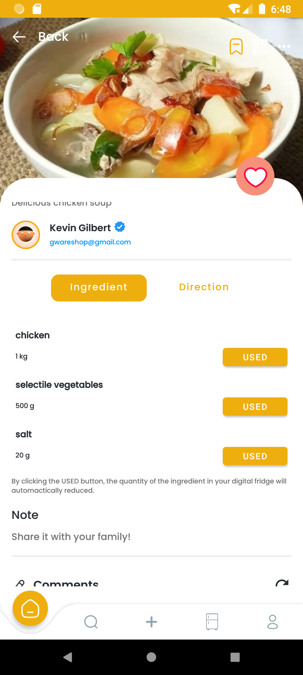
Function Achieved
Auto-create A New Item If Lacking That Ingredient
3
This page will auto-created and auto-filled with the ingredient lacking when you click the “USED” button on the recipe detail page but your fridge does not have sufficient storage.
A toast will show to notify you to buy more.

Slide 25
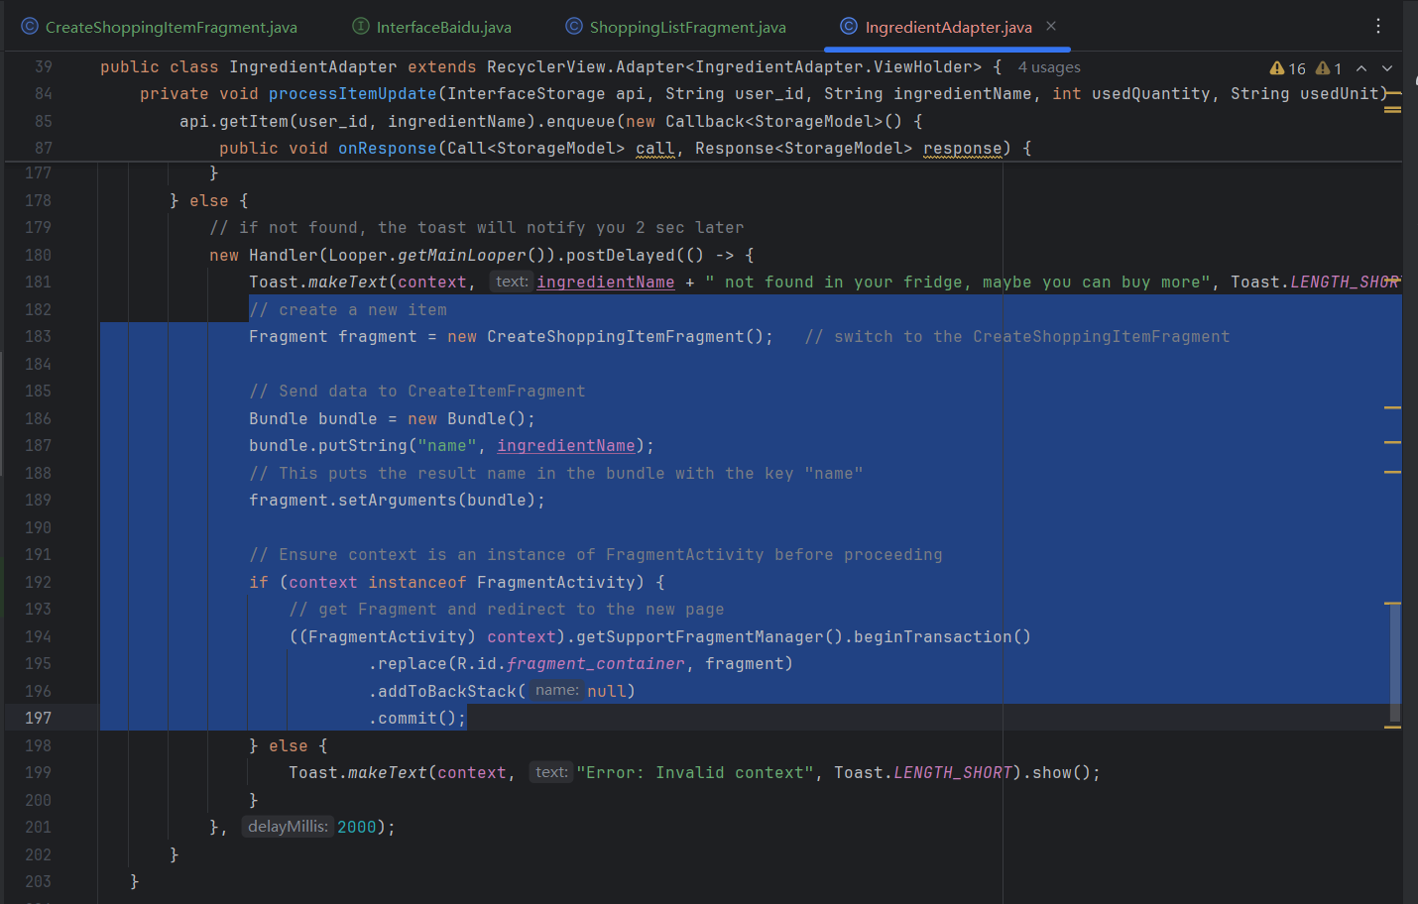
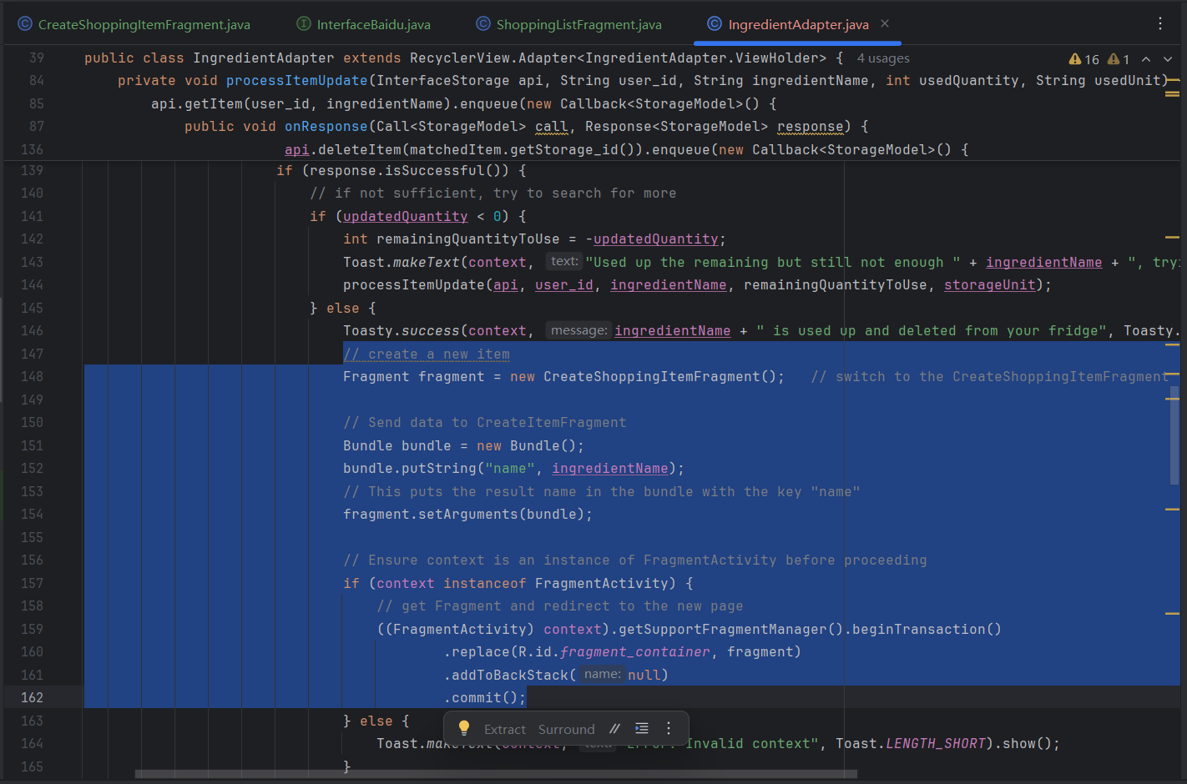
Code explanation
This part of fragment transactions will take care of that link between the recipe detail page and the shopping list pages.

Slide 26
Description of Finalized Features/ Improvement | Progress
Feature 3 (Newly added): AI-supported Image Recognition: Complete the scan item function by introducing the image-recognition technique to automatically add new item to the digital fridge. Add Shopping List Pages: A shopping list supports handwriting or scan item’s image to add new items. Auto-create A New Item If Needed: A new item can be created automatically when you lack the ingredient in your digital fridge when using the recipes. | Done.
Improvement 3: Auto-create A New Item If Needed: A new item can be created automatically when you lack the ingredient in your digital fridge when using the recipes. | Done.

Slide 27
THANKS FOR WATCHING

